Slide 1
DNS Configuration using BIND server
Gouasmia zakaria
Gouasmia.zakaria1@gmail.com

Slide 2
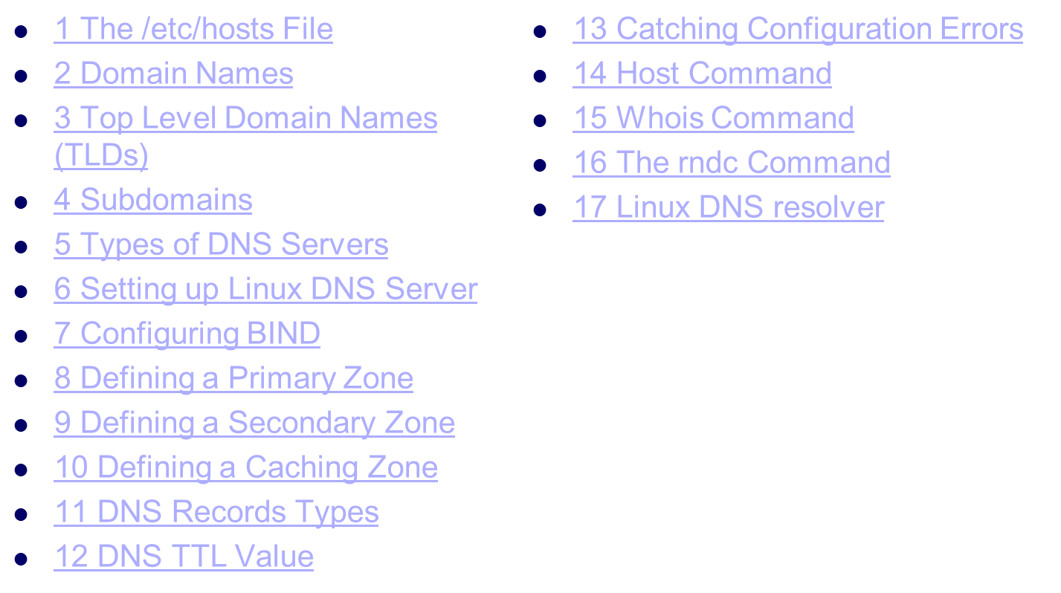
Presentation Outline

Slide 3
Introduction
The DNS (Domain Name System) is a naming system for computers, the service that does that is called DNS server which translates an IP address to a human readable address. This process is the backbone of the internet and a very important service in your server, so from that point, we will discuss DNS server or specifically Linux DNS server and how to install, configure and maintain it.

Slide 4
The /etc/hosts File
Without the need for a DNS server, every system will have to keep its own copy of the table of the host names and their IP addresses.
On Linux systems, this table is the /etc/hosts file.
So even if you don’t have a DNS server or DNS server is unavailable, this file can translate IP addresses to names using /etc/hosts file.
That means the system query this file first before going to DNS server and if it finds the domain, it will translate it without going to any DNS servers.
Try to edit /etc/hosts and type the following:
127.0.0.1 google.com

Slide 5
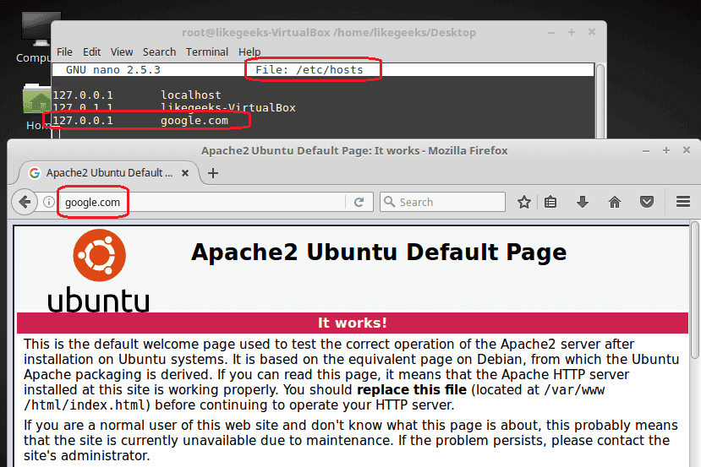

Slide 6
Domain Names
When you visit a website, you type the FQDN (Fully Qualified Domain Name) or the domain name like this: likegeeks.com or www.google.com
Each domain consists of domain components, the dot separates these components.
The text com is the top-level domain component and google is the second-level domain component and www is the third-level domain component

Slide 7
Top Level Domain Names (TLDs)
We saw a top level domain component such as com domains.
Top level domains (TLDs) are divided into categories based on geographical or functional aspects.
There are more than 800 top level domains on the web
The top level domains categories are:
Generic top-level domain like (.org, .com, .net, .gov, .edu and so on).
Country-code top-level domains like (.us, .ca and so on)
New branded top-level domains like (.linux, .microsoft, .companyname and so on).
Infrastructure top-level domains like .arpa domain.

Slide 8
Subdomains
When you visit a website like mail.google.com the mail here is a subdomain of google.com.
Only the name servers for mail.google.com know all the hosts existing beneath it, so google answers if there is mail subdomain or not, the root name servers have no clue about that.

Slide 9
Types of DNS Servers
There are three types of DNS servers:
Primary DNS servers: They contain the domain’s configuration files and they respond to the DNS queries.
Secondary DNS server: They work as a backup and load distribution. Primary servers know the existence of the secondary name servers and send updates to them.
Caching DNS server: All they do is caching the DNS responses so you don’t need to ask the primary or secondary DNS server again. You can make your system work as a caching server easily as we will see later on this post.

Slide 10
Setting up Linux DNS Server
There are many packages on Linux that implement DNS functionality, but we will focus on BIND DNS server. It is used on most DNS servers worldwide.
$ apt-get install bind9
Once the installation completed, you can start it:
$ /etc/init.d/bind start (restart // stop )

Slide 11
Configuring BIND
The service configuration is /etc/named.conf file.
There are some statements that BIND uses in that file like:
options used for global BIND configuration.
logging what can be logged and what can be ignored.
zone define DNS zone.
include to include another file in named.conf.

Slide 12
Configuring BIND
The zone statement enables you to define a DNS zone . Like the domain google.com which has also subdomains like mail.google.com and analytics.google.com and other subdomains.
Every one of these three (the domain and subdomains) has a zone defined by the zone statement.

Slide 13
Defining a Primary Zone
To define a primary zone in /etc/bind/named.conf file you can use the following syntax:
zone “itisme.net" {
type master;
file “/etc/bind/db.forward.net “;
};

Slide 14
Defining a Secondary Zone
The same as the primary zone definition with little change.
zone "likegeeks.com" {
type slave;
masters Primary Nameserver IP Address Here; ;
file likegeeks.com.db
};

Slide 15
Defining a Caching Zone
It is necessary but not required to have a caching zone, so you decrease the queries on the DNS server.
zone "." IN {
type hint;
file "root.hint";
};

Slide 16
The second zone
The second zone defined in the /etc/named.rfc1912.zones file and included in /etc/named.conf via include directive which is already included by default.
zone "localhost" IN {
type master;
file "localhost.db";
};

Slide 17
The third zone
The third zone defines the reverse lookup for the localhost.
zone "0.0.127.in-addr.arpa" IN {
type master;
file "127.0.0.rev";
};

Slide 18
Putting these three zones on /etc/named.conf will make your system work as a caching DNS server.
Now you should type the content of the files referenced like itisme.net.db, localhost.db, and 127.0.0.rev
These files contain the DNS record types for each zone with some options. So what are those DNS record types and how they are written?

Slide 19
DNS Records Types
The database files consist of record types like SOA, NS, A, PTR, MX, CNAME and TXT.

Slide 20
SOA: Start of Authority Record
The SOA record describes the site’s DNS entries with the following format:
example.com. 86400 IN SOA ns1.example.com. mail.example.com. (
2017012604 ;serial
86400 ;refresh, seconds
7200 ;retry, seconds
3600000 ;expire, seconds
86400 ;minimum, seconds
)

Slide 21
NS: Name Server Records
You can use the NS record to specify the name servers for a zone.
You can write NS records like this:
t is not required to have 2 NS records, but it is preferred to have backup name servers.
IN NS ns1.example.com.
IN NS ns2.example.com.

Slide 22
A and AAAA: Address Records
The A record maps the hostname to an IP address:
support IN A 192.168.1.5

Slide 23
PTR: Pointer Records
The PTR record is for doing the reverse name resolution, you give an IP address and it returns the hostname.
This is the opposite of what A record does.
Here we type the full host name with the trailing period.
192.168.1.5 IN PTR support.example.com.

Slide 24
MX: Mail Exchange Records
The MX record tells about the mail server records.
example.com. IN MX 10 mail

Slide 25
CNAME: Canonical Name Records
CNAME records are like shortcuts for host names.
Suppose you have a site that has a hostname of whatever-bignameis.example.com and since the system is a web server, an alias of www or CNAME record can be created for the host.
So you can create a CNAME record to make the name www.example.com:
whatever-bignameis IN A 192.168.1.5
www IN CNAME whatever-bignameis

Slide 26
TXT Records
You can put any text on TXT records like your contact information or any other information you want the people to know when they query your DNS server.
You can write TXT records like this:
example.com. IN TXT " YOUR INFO GOES HERE"

Slide 27
DNS TTL Value
In /etc/named.conf on the top there is $TTL entry.
This entry informs BIND about the time to live value for each individual record.
It takes a value in seconds like 14400 seconds (4 hours), so the DNS servers will cache your zone up to four hours then will query your DNS server again.
You can lower the value, but the default value is fair. Unless you know what you are doing.

Slide 28
Catching Configuration Errors
When you write your zone files, maybe you forget a period or space or any other error.
You can diagnose your Linux DNS server errors from the log. The BIND service through errors in /var/log/messages, you can use the tail command to view real-time error log using -f option.
$tail -f /var/log/messages

Slide 29
Linux DNS resolver
We’ve seen how a Linux DNS server works and how to configure it. The other part is the client who is contacting the DNS server.
The client is the resolver, you can check the configuration file /etc/resolv.conf
On Debian based distros, you can check /etc/resolvconf/resolv.conf.d/ directory.
The /etc/resolv.conf file contains the local DNS servers that the system uses.

Slide 30
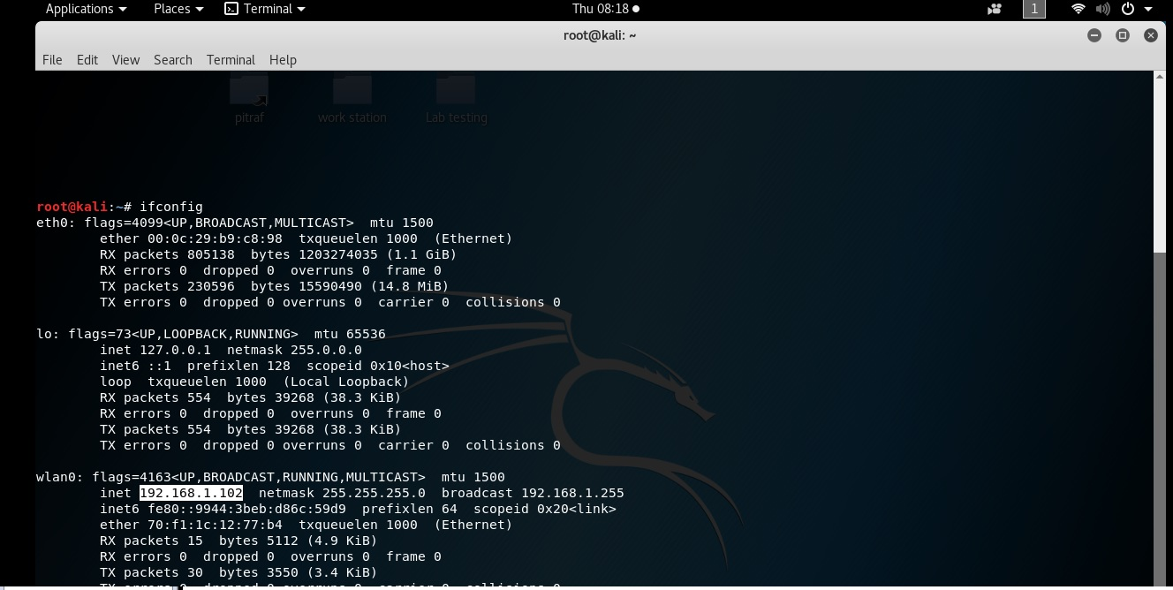

Slide 31
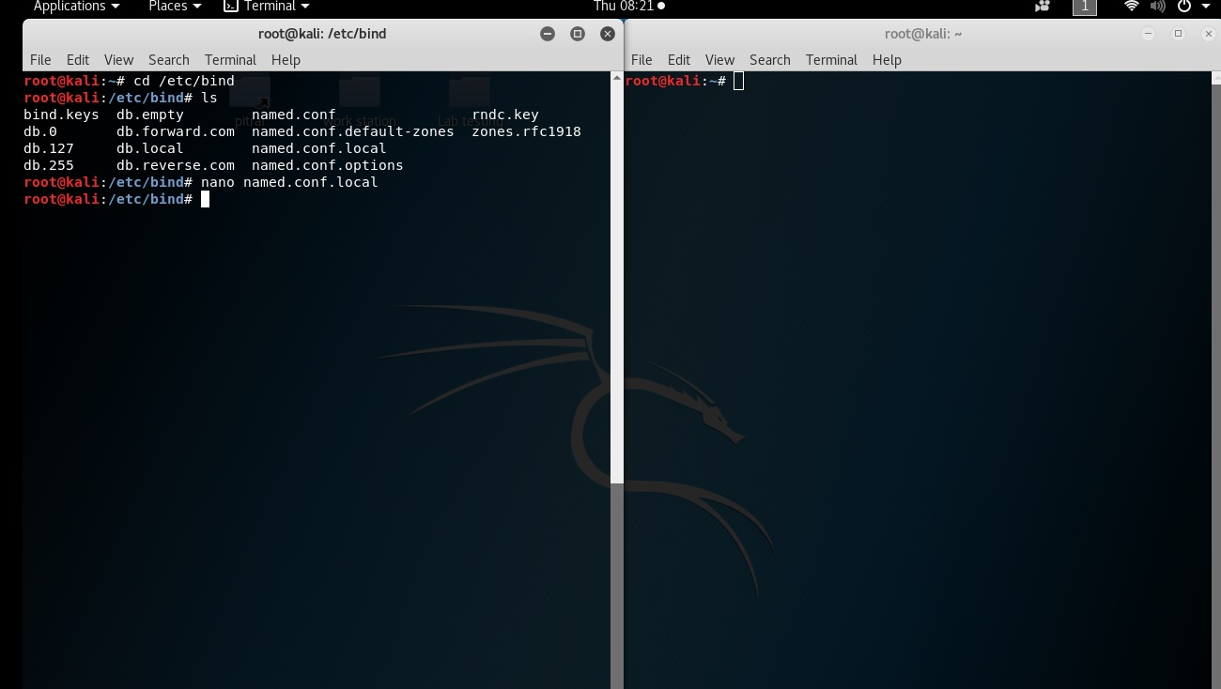

Slide 32
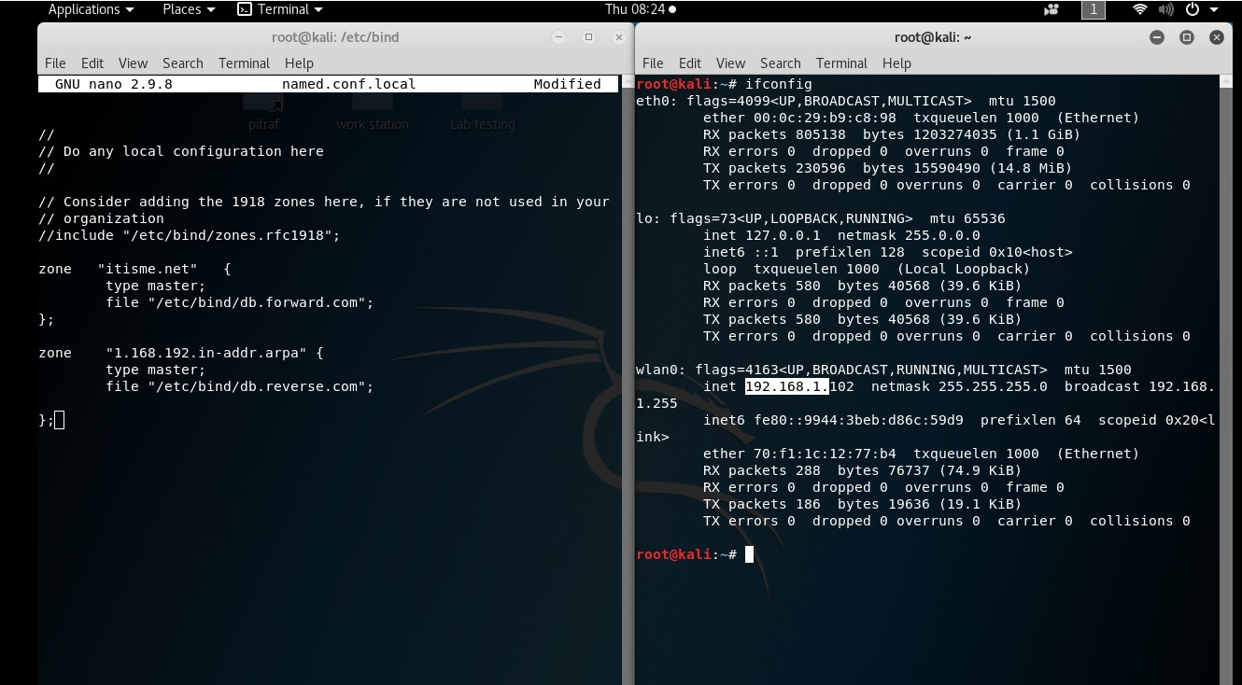

Slide 33
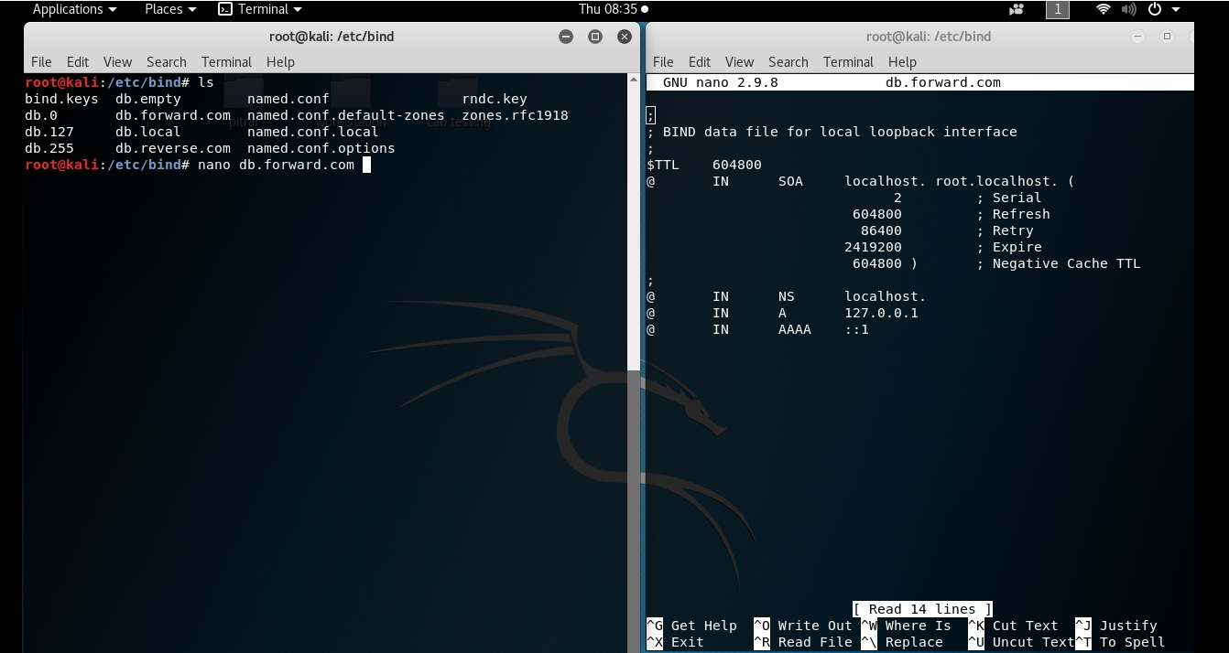

Slide 34
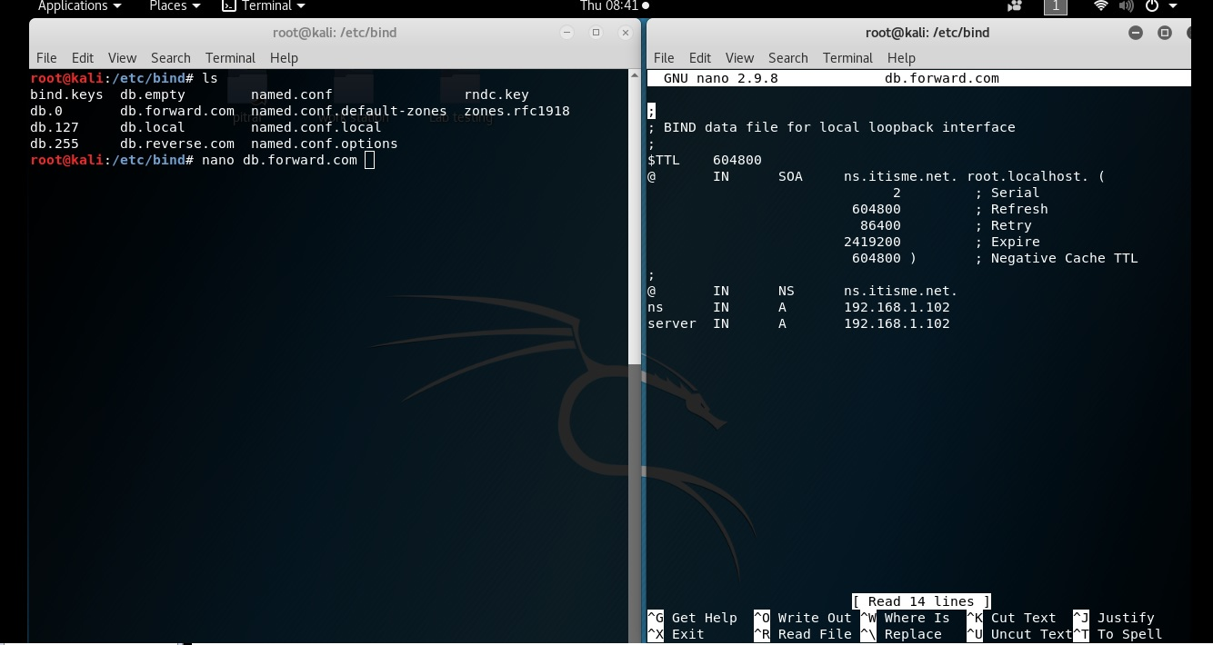

Slide 35
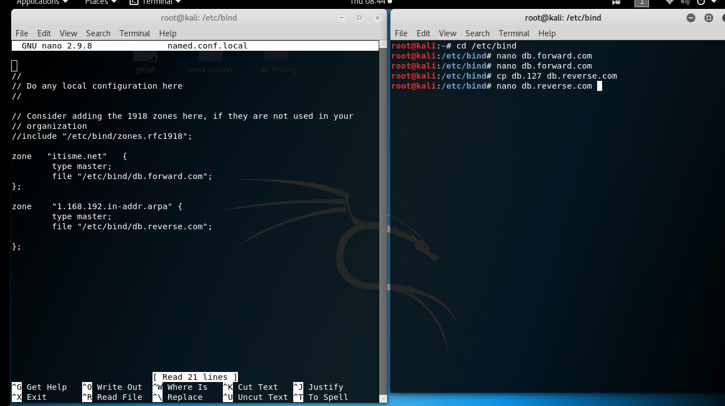

Slide 36
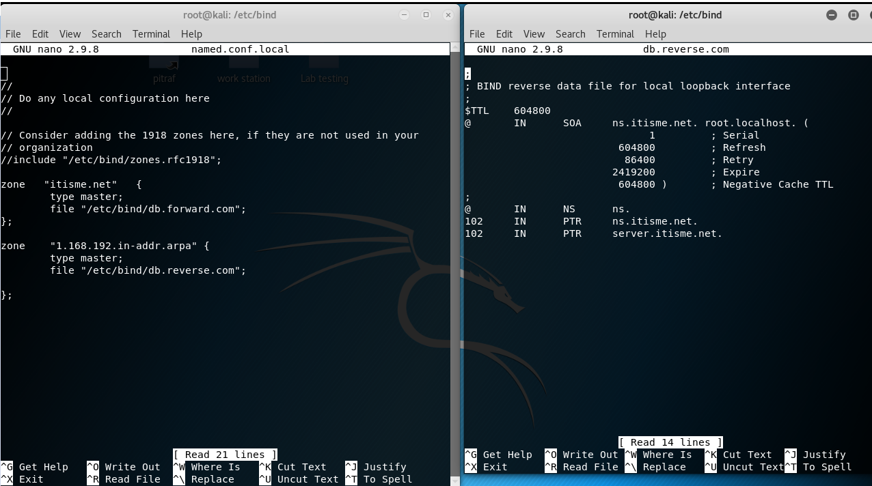

Slide 37
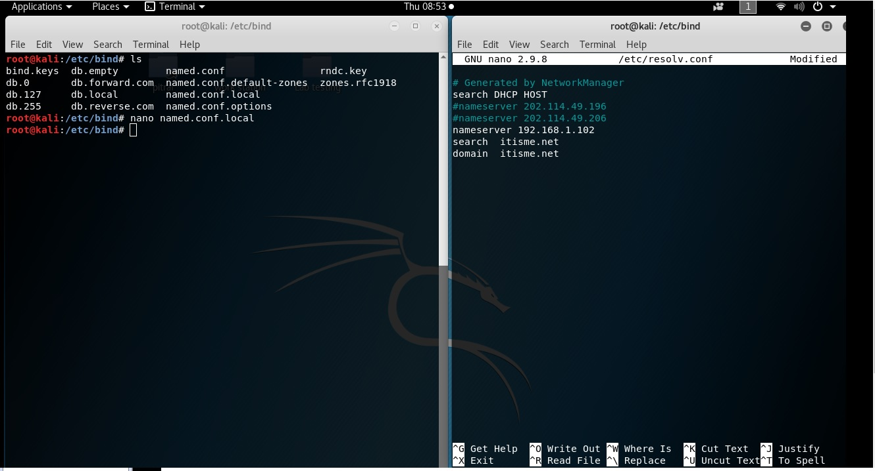

Slide 38
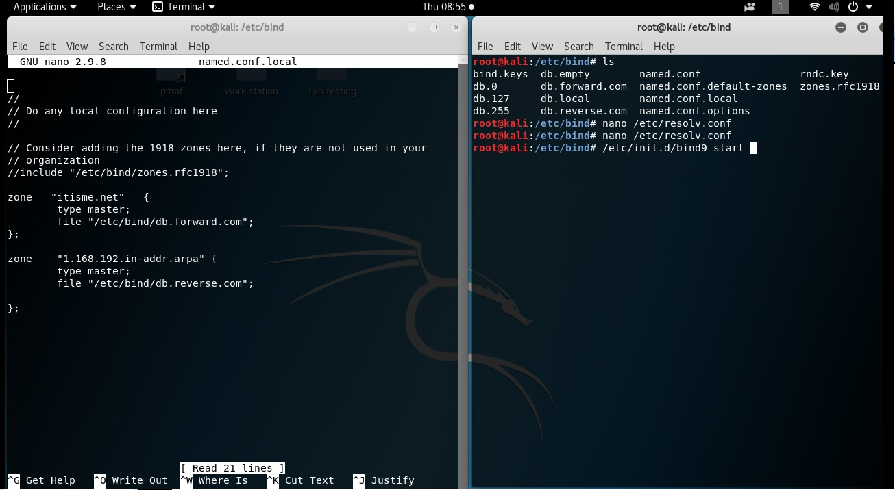

Slide 39
NSLOOKUP
nslookup (name server lookup) is a tool used to perform DNS lookups in Linux. It is used to display DNS details, such as the IP address of a particular computer, the MX records for a domain or the NS servers of a domain.
$ nslookup ns.itisme.net
$nslookup 192.168.1.102

Slide 40
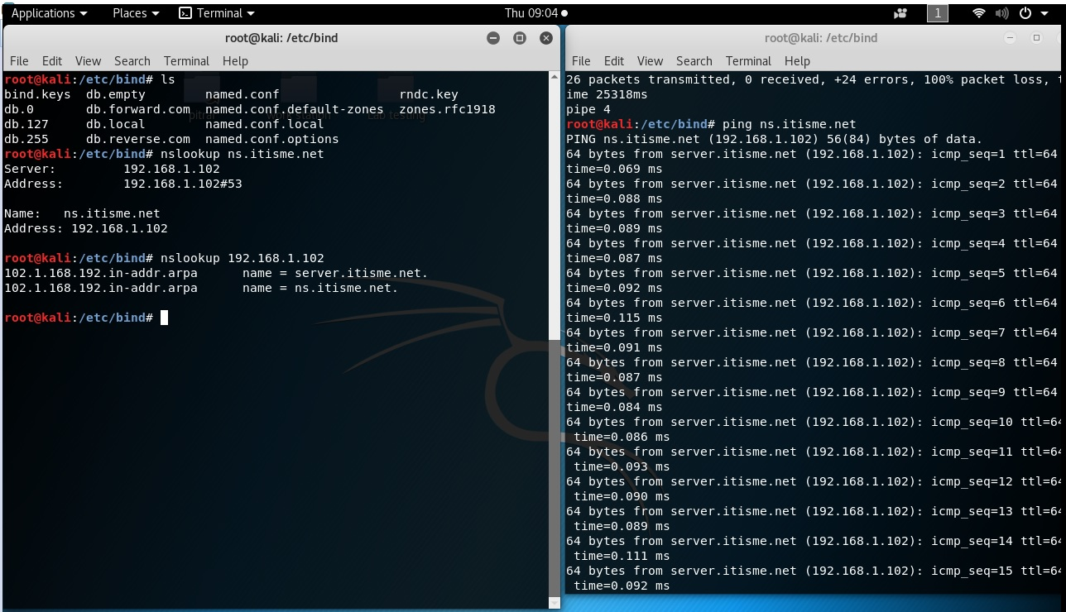

Slide 41
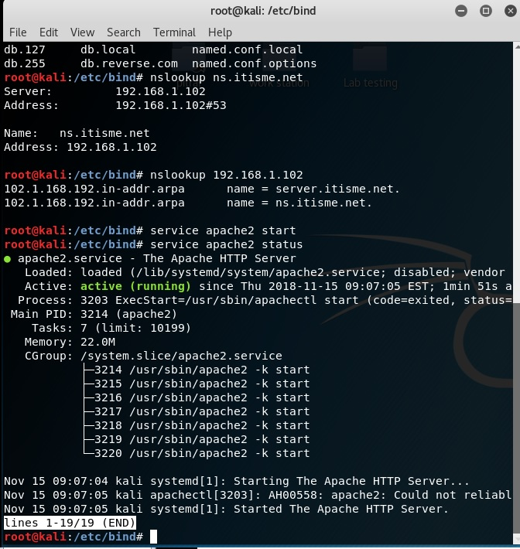

Slide 42
The rndc Command
The rndc tool can be used to manage the name server securely.
You can check the status of the Linux DNS server like this:
$ rndc status
Also, if you make a change to any of the zone files, you can reload the service without restart the named service.
$ rndc reload example.com

Slide 43
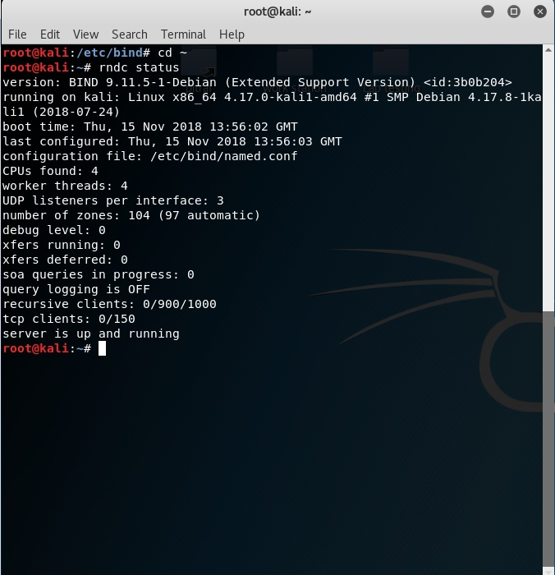

Slide 44
Host Command
After you have successfully added or modified your records, you can use the host command to see if your host if resolved correctly.
If you give it a hostname, it will answer with the corresponding IP addresses.
$ host example.com
$ host 192.168.1.5

Slide 45
Whois Command
The whois command is used to get the domain owner’s details.
Also, the owner’s email addresses, and contact phone numbers.
$ whois example.com

Slide 46
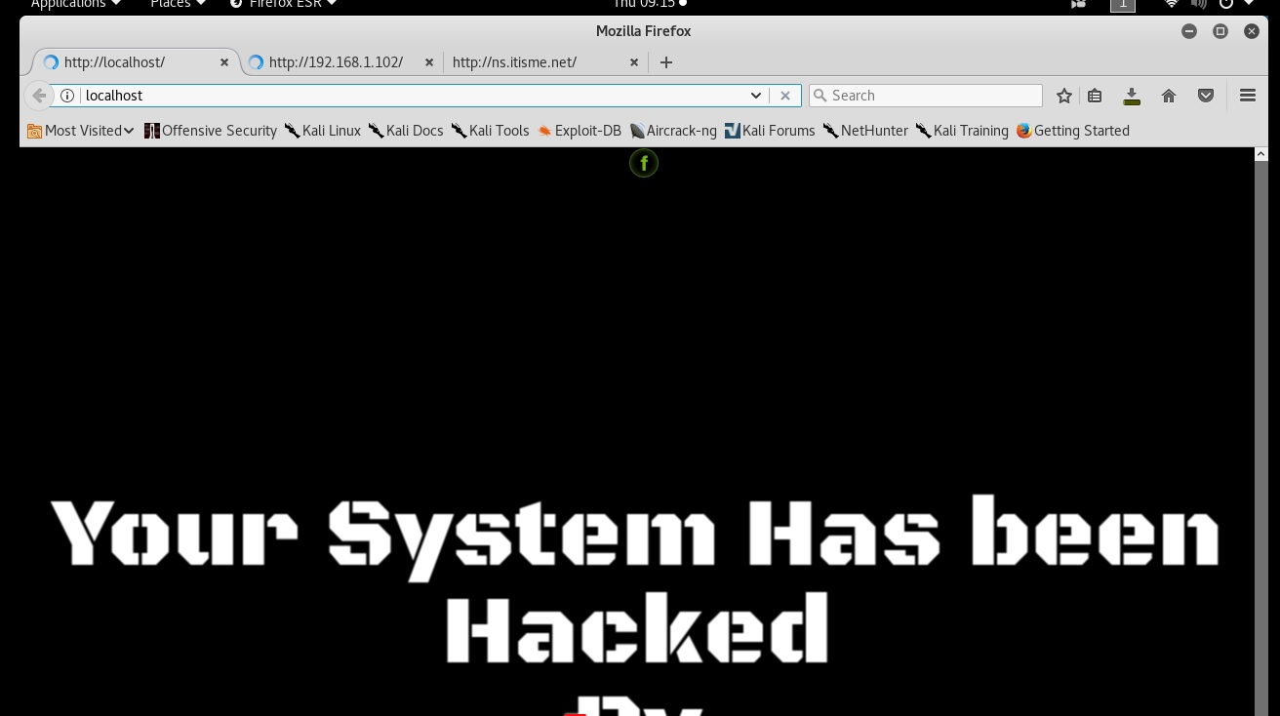

Slide 47
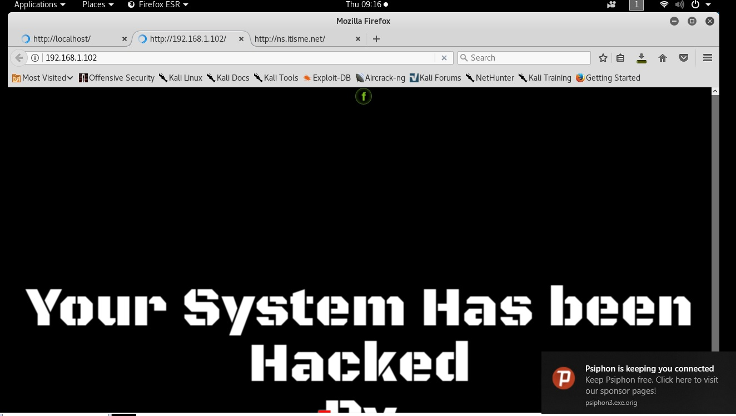

Slide 48
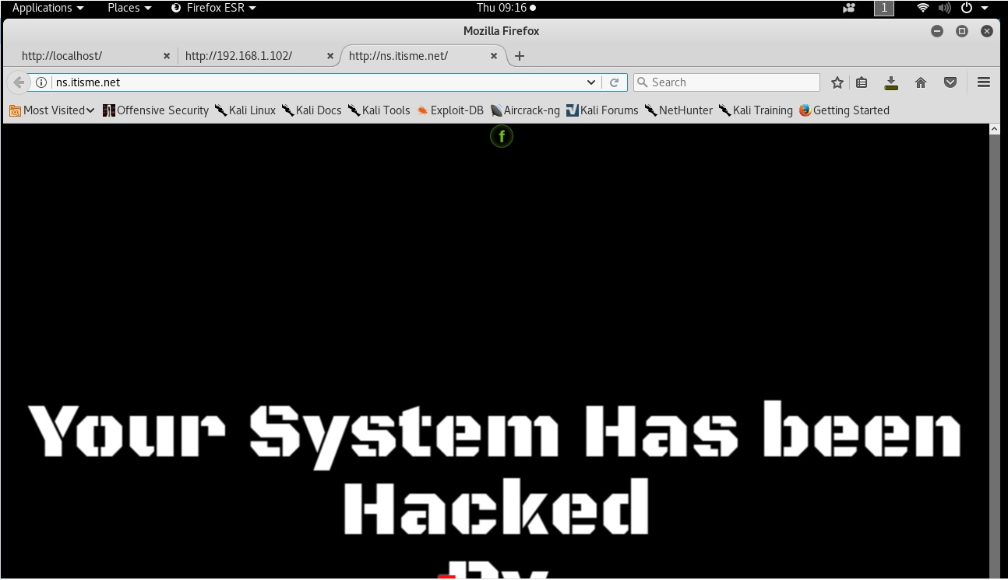

Slide 49
Thank You!!

